Slide 1
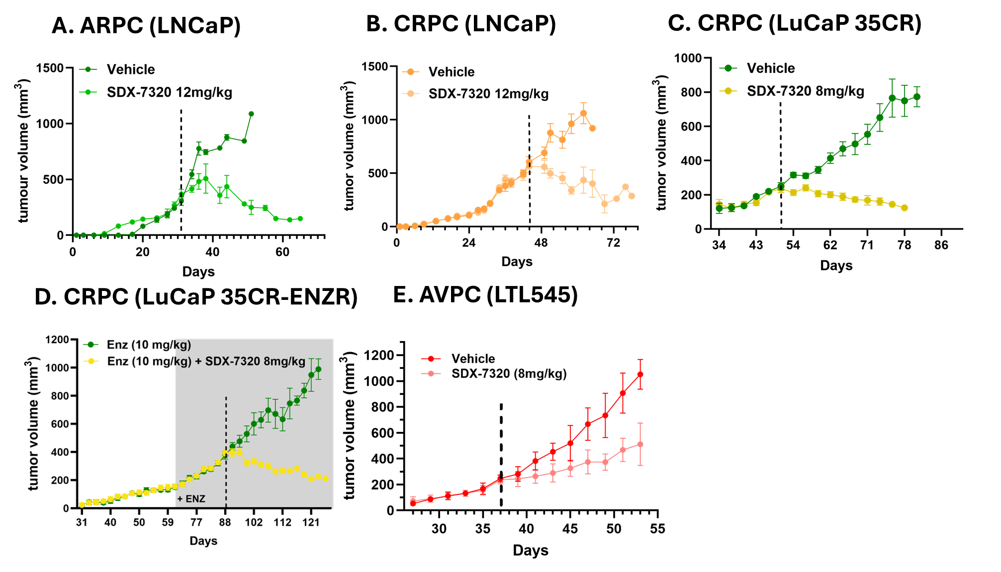
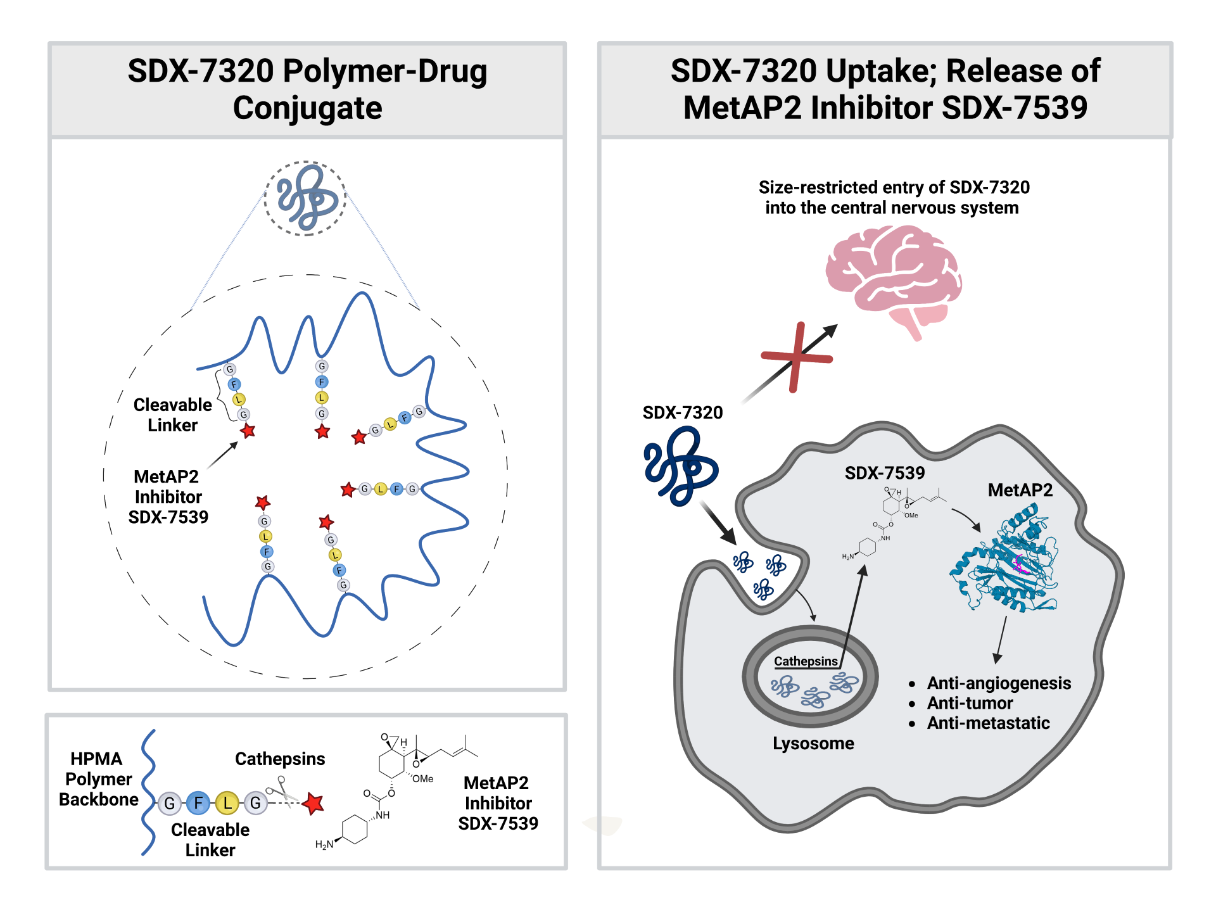
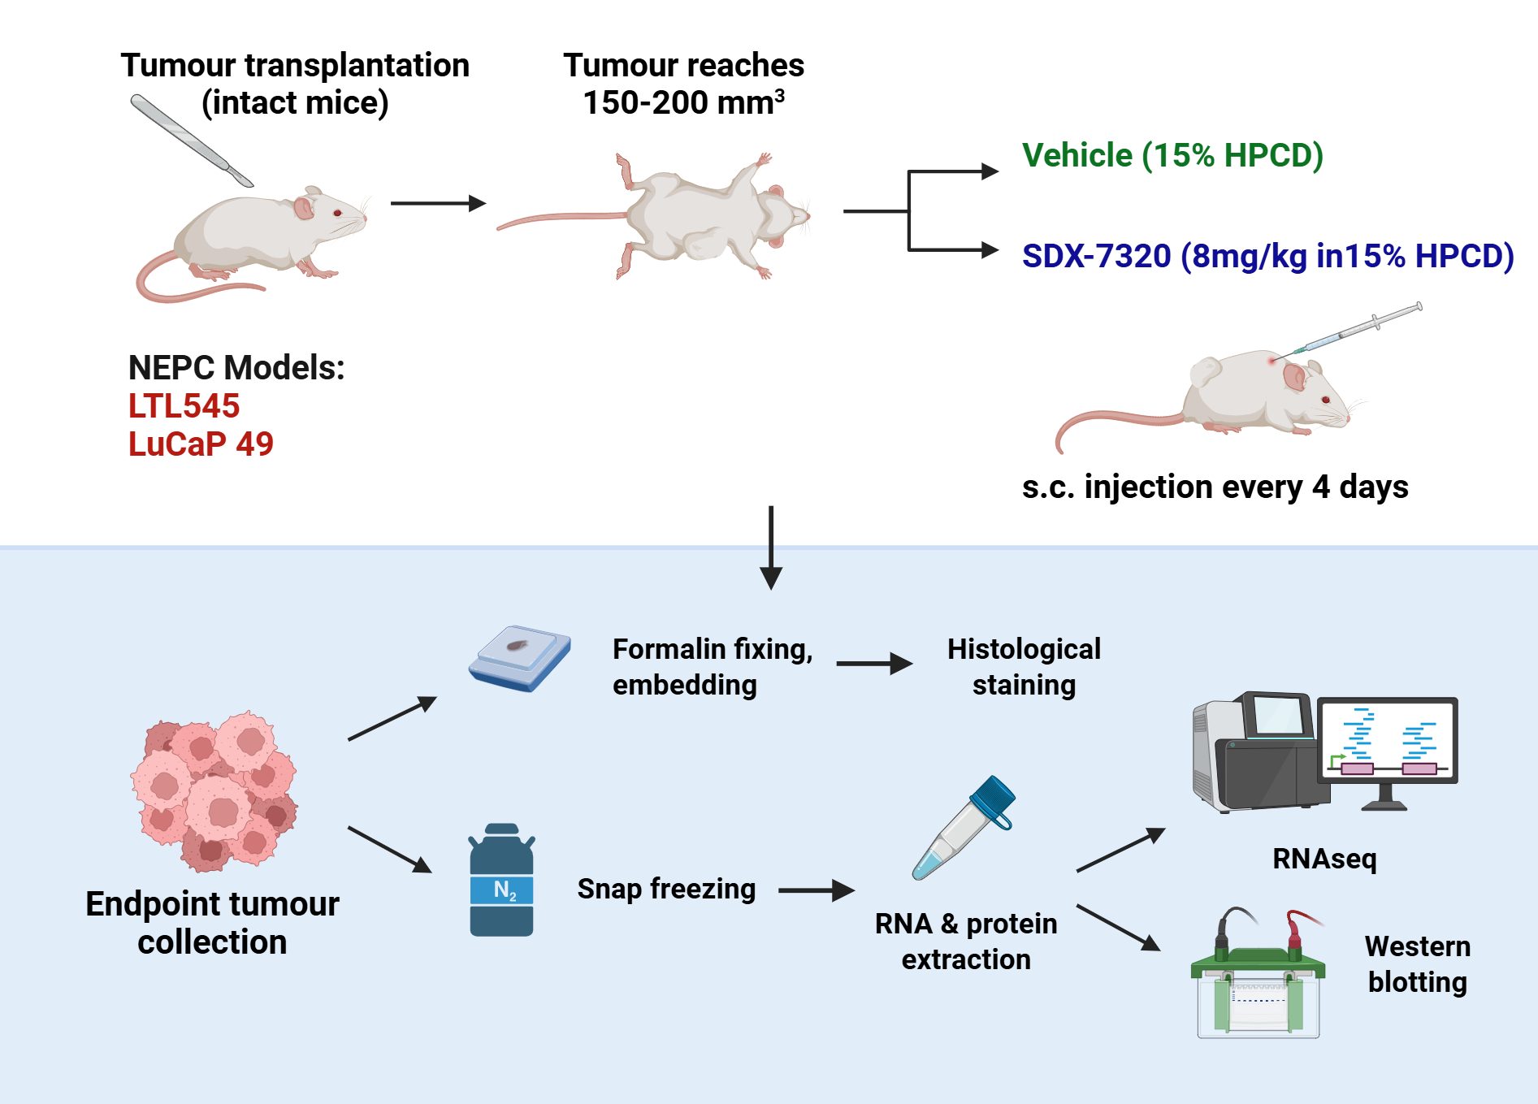
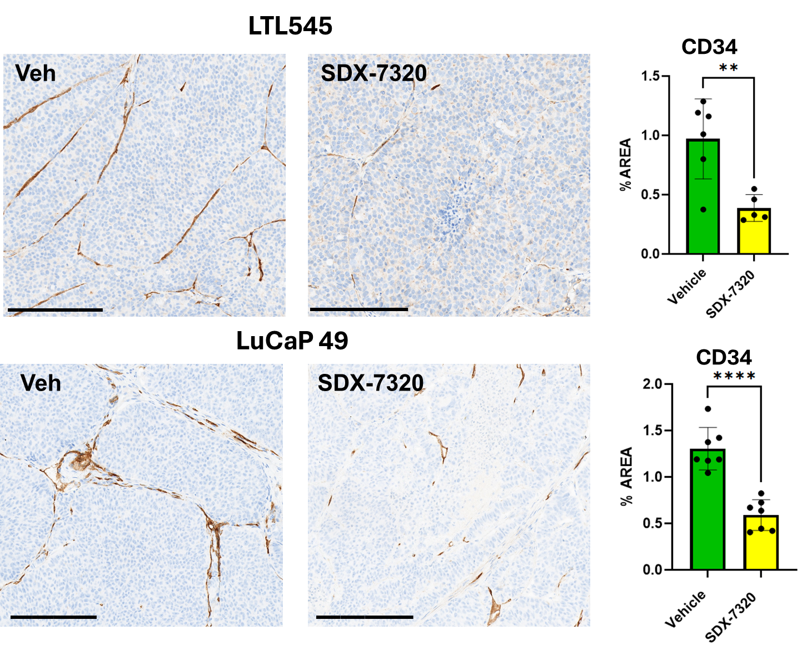
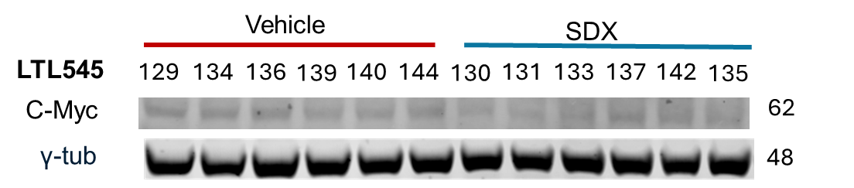
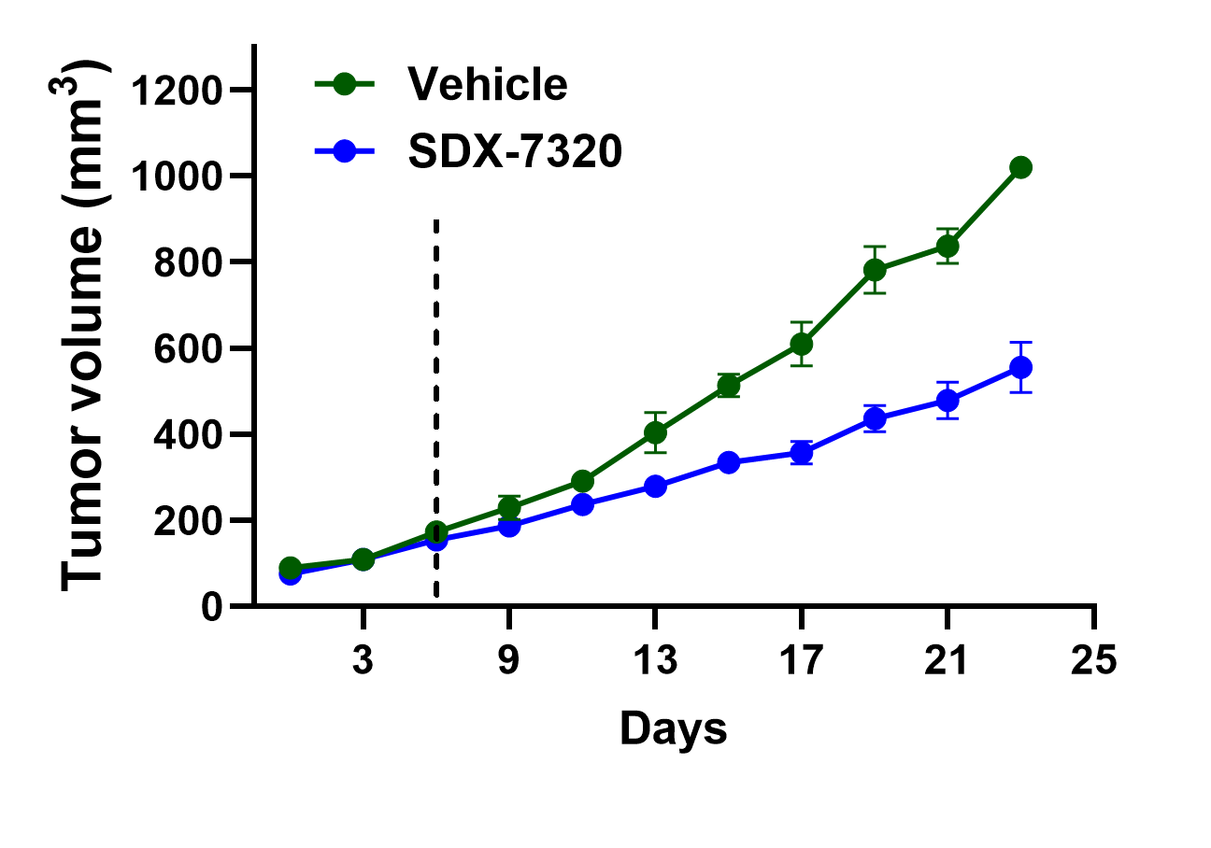
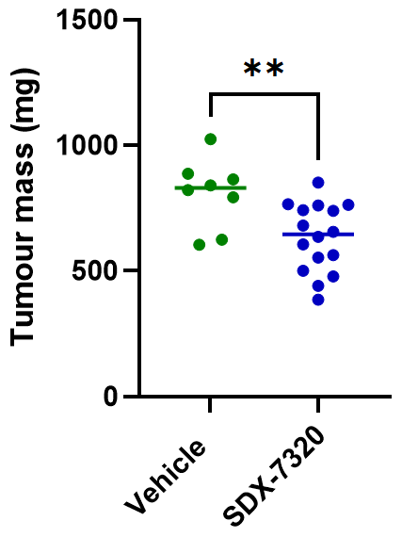
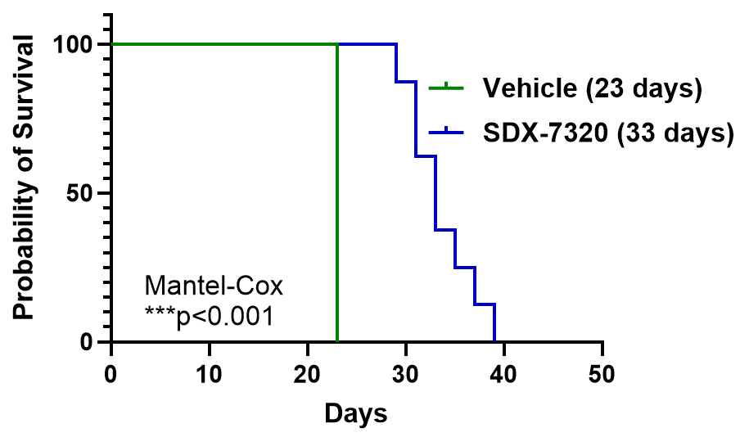
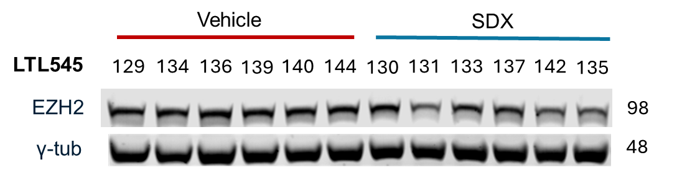
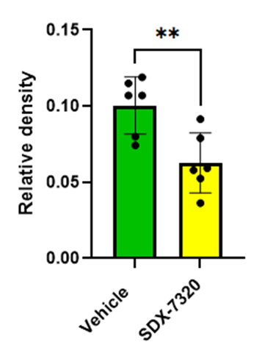
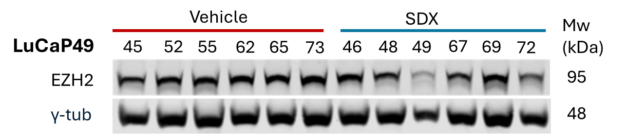
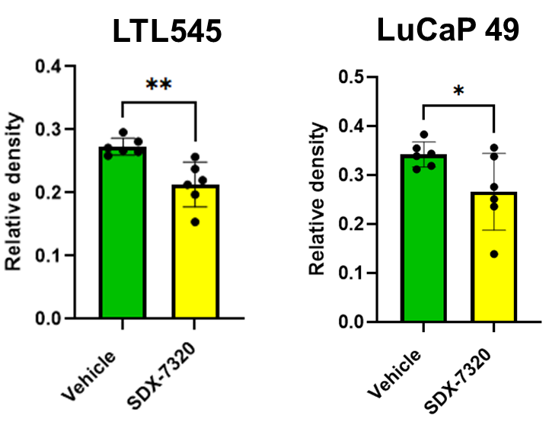
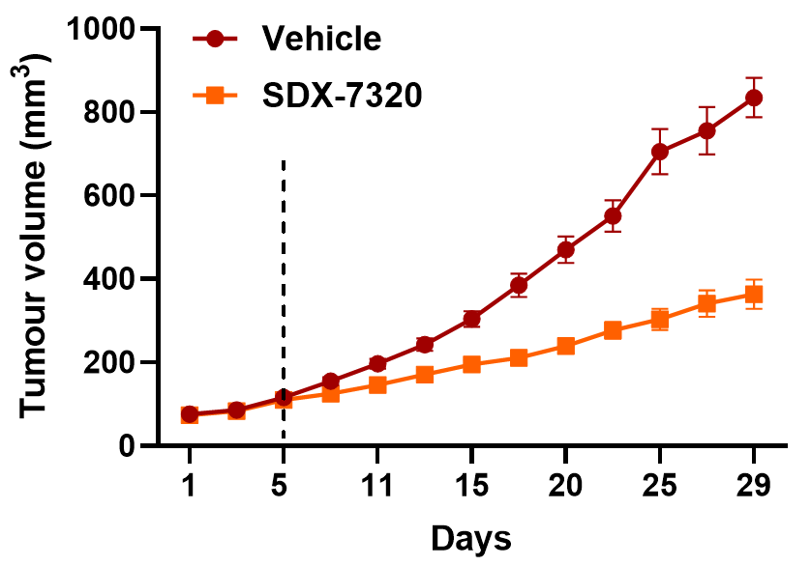
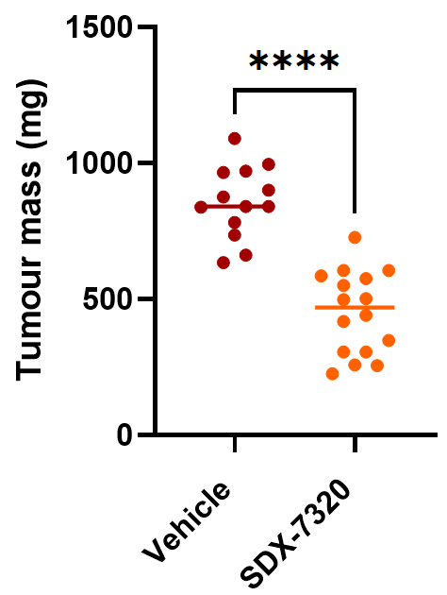
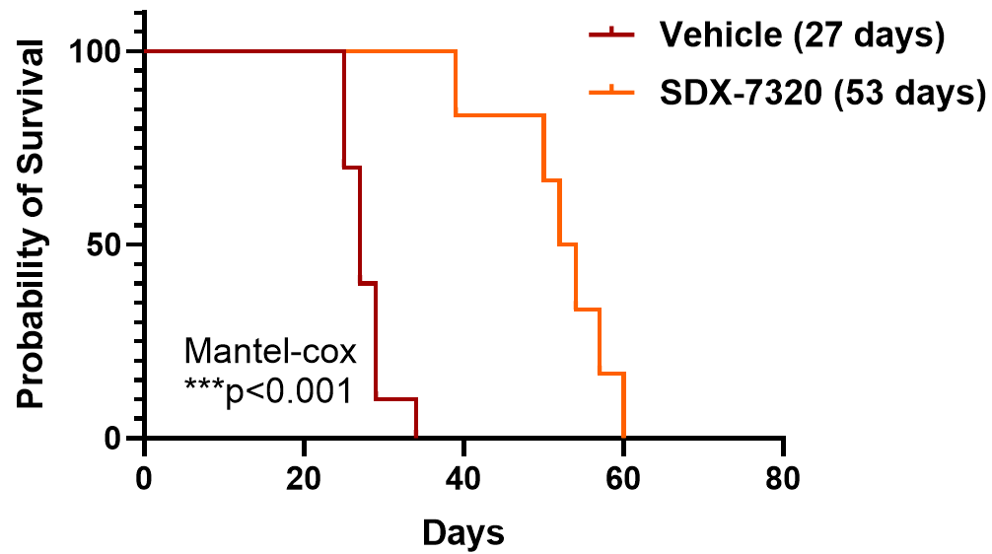
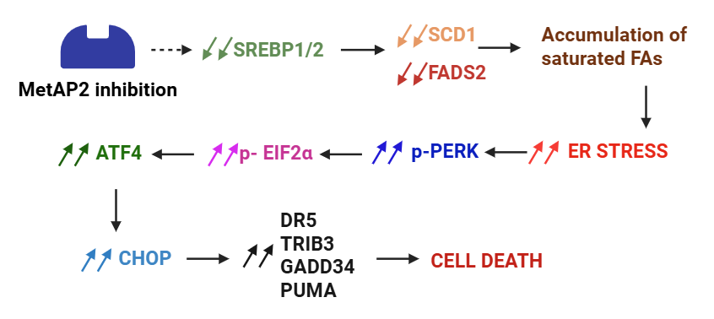
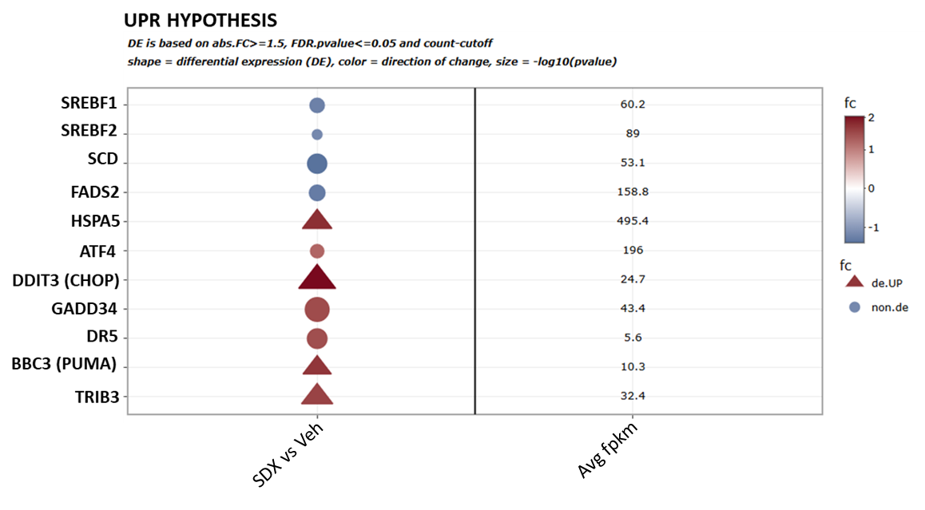
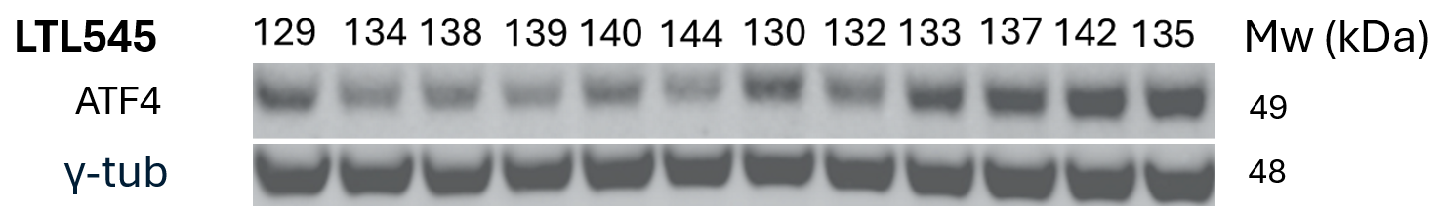
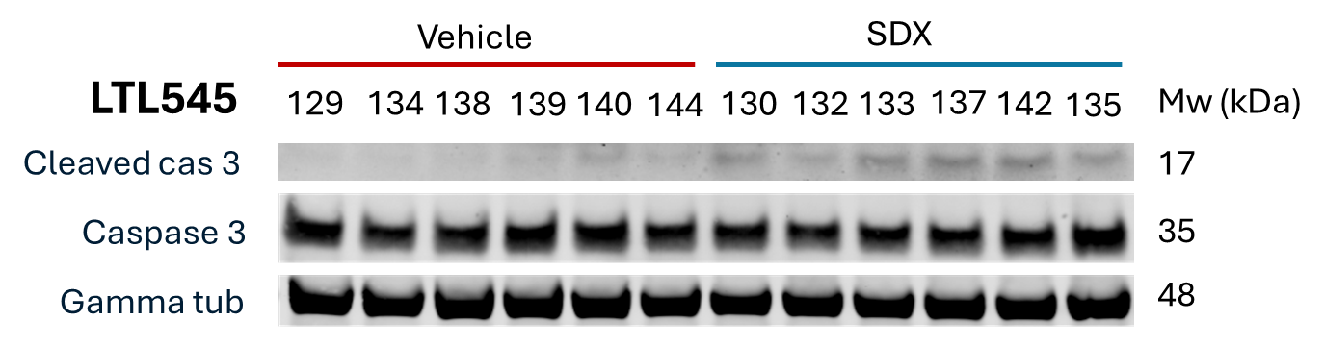



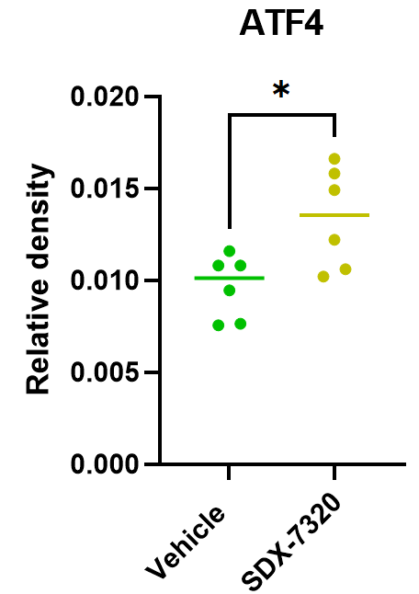
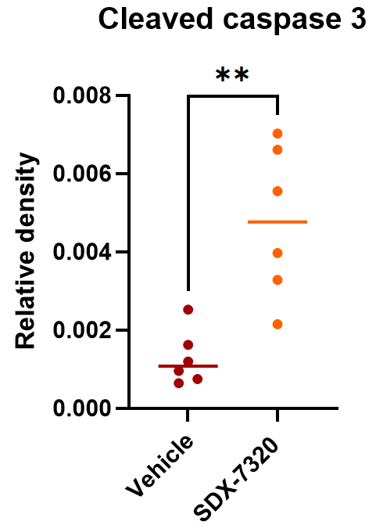

The methionine aminopeptidase-2 inhibitor, evexomostat, potently suppresses tumour growth in aggressive variant prostate cancer models
Devina Laurencia¹ , Jennifer H. Gunter¹ , Thomas Tang¹, Peter Cornelius² , Benjamin A. Mayes² , Anja Rockstroh¹ , Lisa Philp¹, Eva Corey³, YZ Wang⁴ , Pierre J. Dufour², Bradley J. Carver², James M. Shanahan² , Colleen C Nelson¹
¹Australian Prostate Cancer Research Centre – Qld, Centre for Genomics and Personalised Health, School of Biomedical Science, Queensland University of Technology, Translational Research institute, Brisbane, Australia. ²SynDevRx, Inc, Cambridge, MA. ³Department of Urology, University of Washington, Seattle, WA. ⁴Vancouver Prostate Centre, University of British Columbia, Vancouver, Canada.
Contacts: Devina.Laurencia@HDR.qut.edu.au
FPN: 2505P
Background
SDX-7320
Methods
The emergence of treatment-resistant aggressive variant prostate cancer (AVPC) following the prolonged clinical use of androgen receptor (AR)-targeted therapies has created an urgent need for effective, AR- independent therapies.
Methionine aminopeptidase-2 (MetAP2), a regulator of protein synthesis, metabolism, plasticity and angiogenesis, is highly expressed in AVPC and correlates with disease aggressiveness¹.
We have previously demonstrated that the MetAP2 inhibitor, SDX-7320/evexomostat² potently suppressed tumour growth in androgen sensitive, castrate-resistant and enzalutamide-resistant prostate cancer models (Fig 1). This prompted investigations into its efficacy in the more aggressive models of prostate cancer which no longer express AR.
We aimed to assess the efficacy of evexomostat in aggressive variant prostate cancer models and identify key mechanisms which may underpin its anti-tumour activity.
Figure 1. SDX-7320 potently reduced tumour growth in models of androgen-sensitive (A), castrate-resistant(B&C), and enzalutamide-resistant prostate cancer (D). Dotted line indicates time of randomisation. Tumour was grown in intact (A) and castrate mice (B-D). Mice were given enzalutamide daily until failure to establish resistance (D).
1) Xie J. et al. Cancer Res. 2021;81(9):2510-21. 2) Cornelius P. et al Mol Cancer Ther. 2024;23(5):595-605
Cornelius et al. 2024, Mol Cancer Ther
Created with Biorender
SDX-7320 potently suppressed tumour growth in LTL545 and LuCaP 49 models of aggressive variant prostate cancer
SDX-7320 treatment significantly reduced the angiogenesis marker CD34
SDX-7320 downregulates c-Myc and enhancer of zeste homolog 2 (EZH2), important regulators of cancer stemness
LTL545
A.
A.
C-Myc protein levels
B.
EZH2 protein levels
A.
Tumour volume
B.
Tumour mass
C.
Survival
Mw (kDa)
Mw (kDa)
C-Myc levels
LuCaP 49
B.
EZH2 levels
D.
Tumour volume
E.
Tumour mass
F.
Survival
Figure 4. Protein levels of c-Myc and EZH2 were measured using western blot and normalised to γ-tubulin (A & B). SDX-7320 treatment significantly reduced c-Myc and EZH2 levels.
Conclusion
Figure 2. SDX-7320 treatment significantly reduced tumour growth (A, D) and endpoint tumour mass (B,E) in LTL545 and LuCaP 49 models of NEPC, prolonging median survival by 43.5% (C) and 92% (F) respectively.
Figure 3. Immunohistological staining of vehicle and SDX-7320-treated tumours against CD34, a marker of angiogenesis. Staining performed on LTL545 model (A) and LuCaP 49 model (B).
Evexomostat significantly suppressed tumour growth in AR- aggressive variant NEPC models.
Several molecular mechanisms may account for its anti-tumour activity, including suppression of angiogenesis (marked by reduced CD34 staining), suppression of cancer stemness regulators (c-Myc and EZH2), and activation of the unfolded protein response.
SDX-7320 induced activation of the unfolded protein response (UPR) and apoptosis in LTL545 model
B.
C.
A.
Genes involved in lipid metabolism and the UPR
Our findings support the advancement of SDX-7320 (evexomostat) to clinical trials for patients with advanced prostate cancer, where there is a high clinical need for novel effective therapeutics.
Figure 5. Differential gene expression between vehicle and SDX-7320-treated group, encompassing markers of lipid metabolism and UPR (A). Western blot of ATF4 (UPR marker) and cleaved-caspase 3 (apoptosis marker) (B). Diagram of hypothesis of anti-tumour mechanism following SDX-7320 treatment in the LTL545 model (C). Changes in lipid metabolism may lead to accumulation of saturated FAs, which may trigger ER stress and induce cell death.
Funding acknowledgements: This research was funded by US Department of Defense (HT9425-24-1-0654)
The first and presenting author declares no conflict of interest

